Slide 1
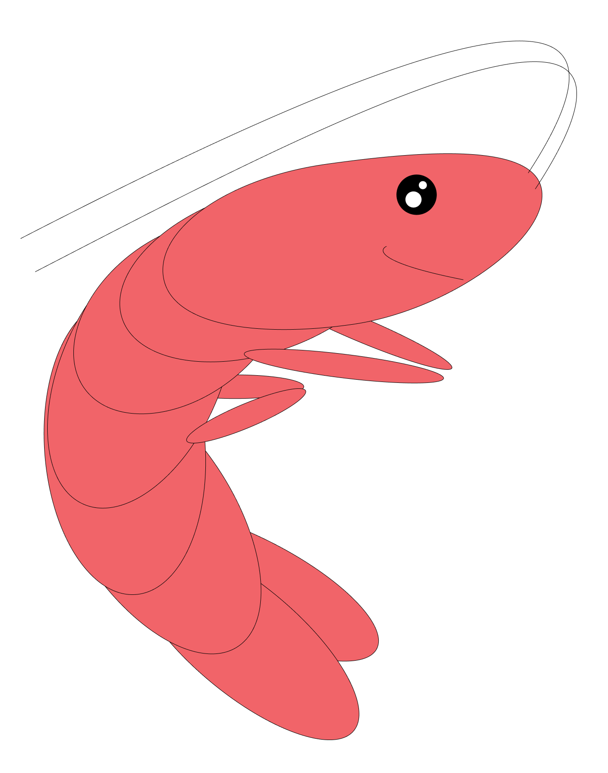
RestauWants
Uniting food lovers,
one plate at a time!

Slide 2
Focused on the primary use case and take into account our feedback from milestone 2 or earlier.
Followed the project plan while adapting dynamically.
Continuously worked throughout the semester.
Demonstrated an interesting, self contained, useful, and live application.
Provided a link to a live application.
Implemented a set of polished features.
Gave a good presentation (simple, clear, focused, time-framed, sincere).
Kept documentation up to date
Summarized insights on user testing
Tell us how you plan to monetize their product.

Slide 3
Planning Slide
The future
Pitch
Demo
User Feedback
Monetization
1 mins
Devin
1.5 mins
Norman
5 min
Callum
1.5 mins
Nick
1 mins
Becca

Slide 4
Persona for demo
Monica
-Organized
-Private
-Food lover
As Monica I want to
Log in
Make a review
  Add photos!
Make friends
  Send request
  Accept request
Make a review
  Add photos!
If there is time,
  Edit post
  Delete post

Slide 5
$2500.
That’s $37 billion.

Slide 6
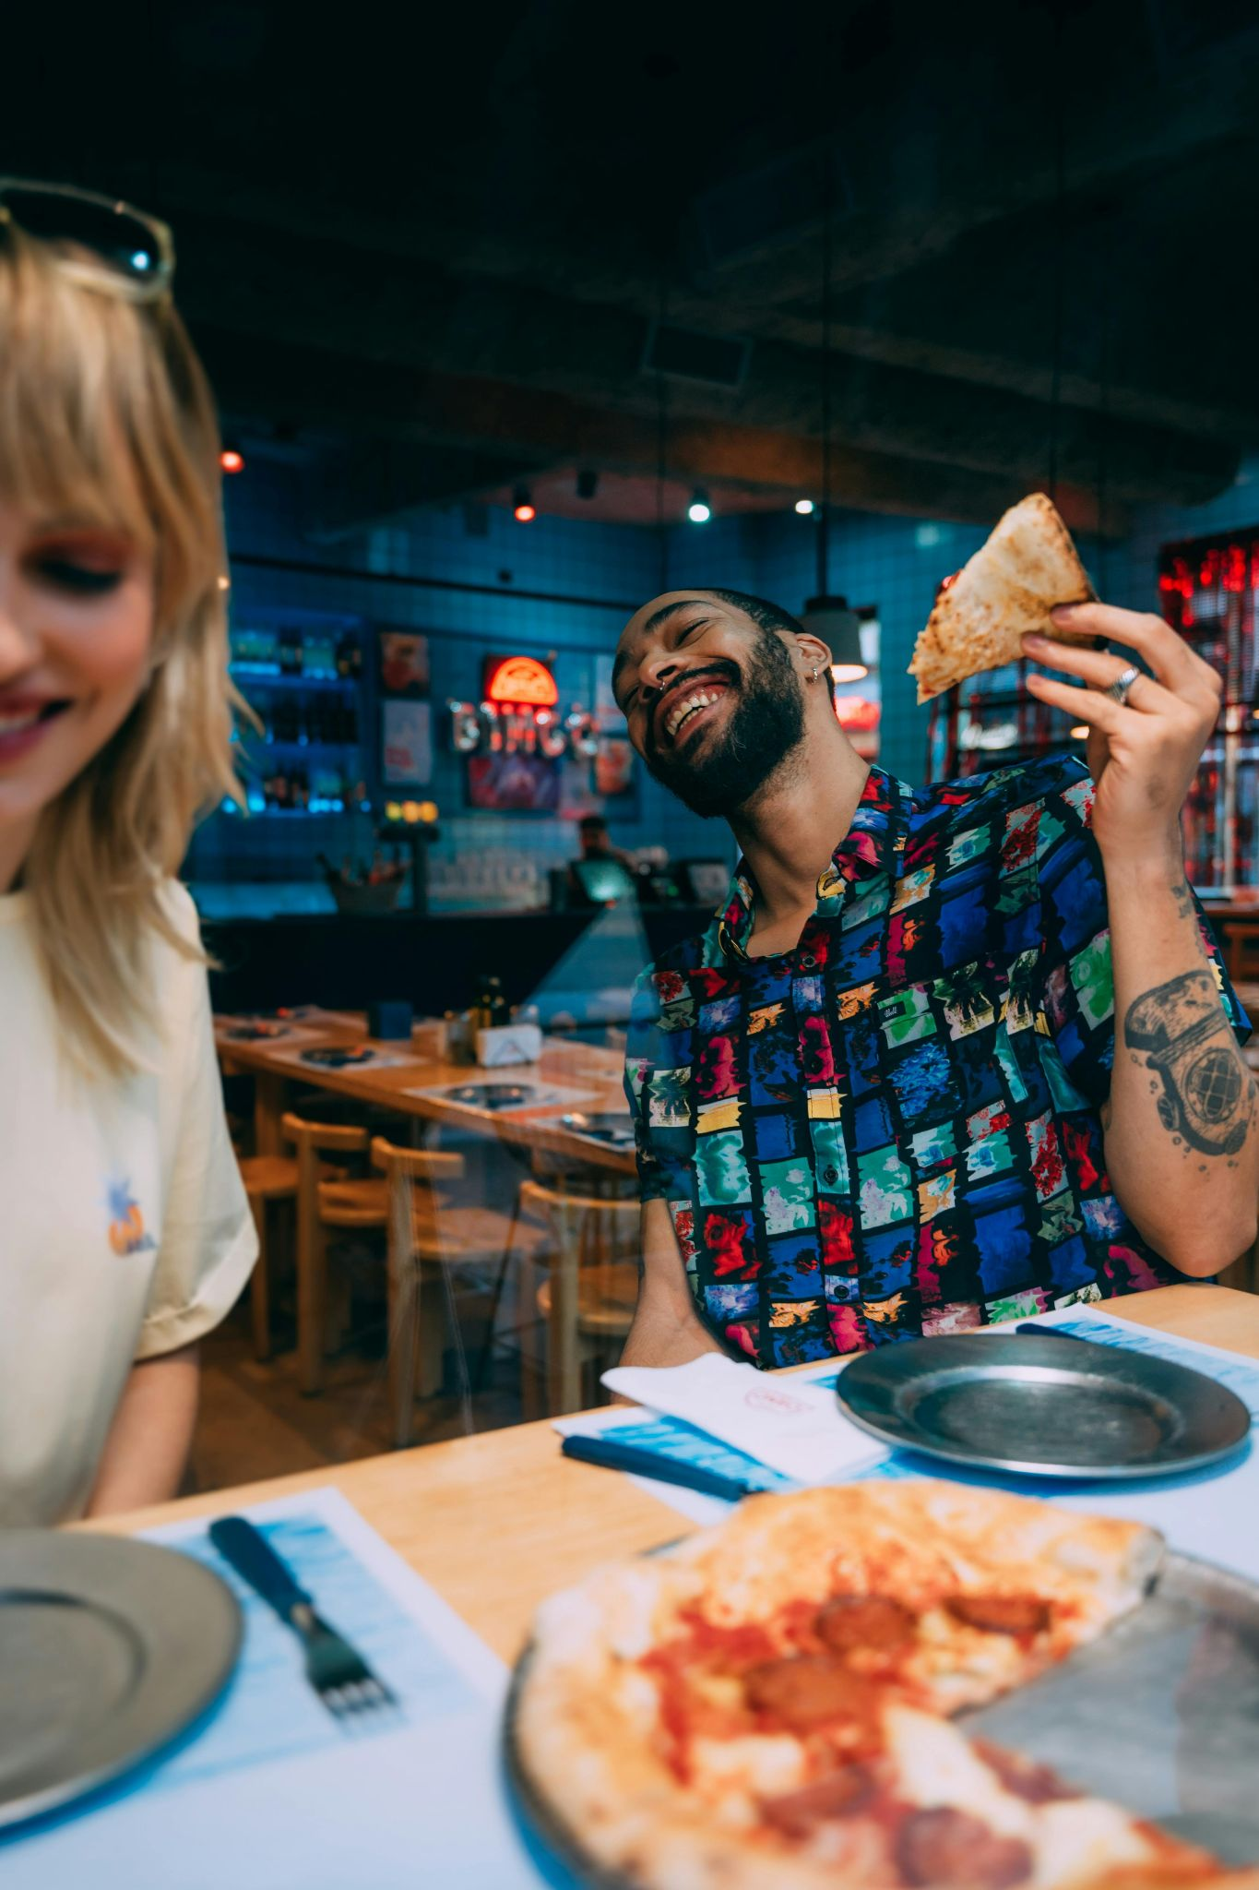
Personal taste is so important.

Slide 7
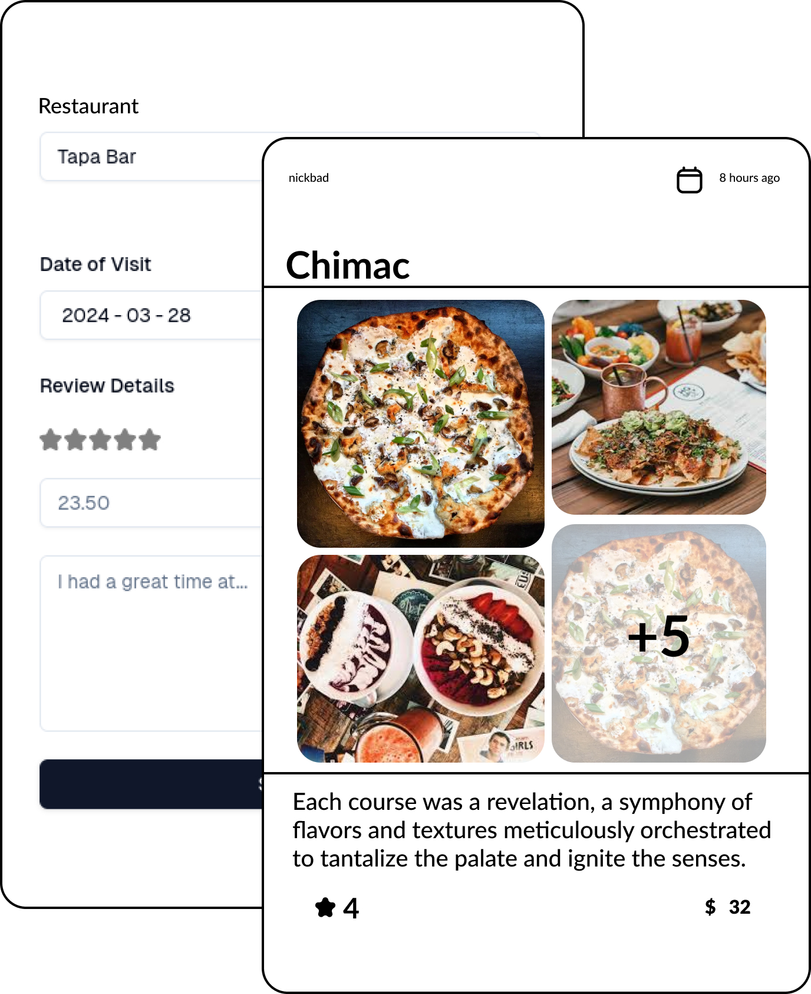
A real app, with real users.
www.restauwants.com

Slide 8
Demo
Notes:
Callum

Slide 9

User Feedback
“I would literally start using this today.”
“I have a lot of friends that would love using this app.”
“Looks very clean and easy to navigate.”
“There are a few features I wish you had.”

Slide 10

The Future
-New Features
-Improved Navigation
-Continuing to build our brand

Slide 11
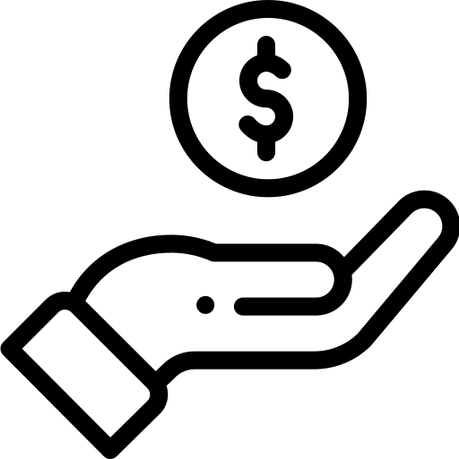
Monetization
Advertisements
Tiered Membership
Restaurants

Slide 12
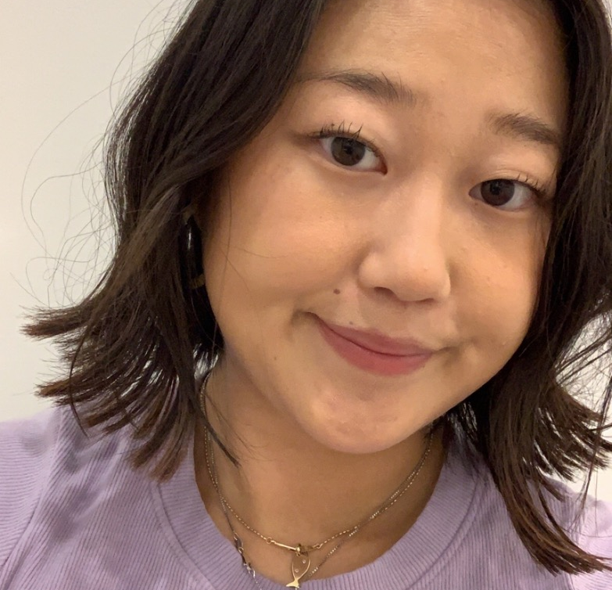
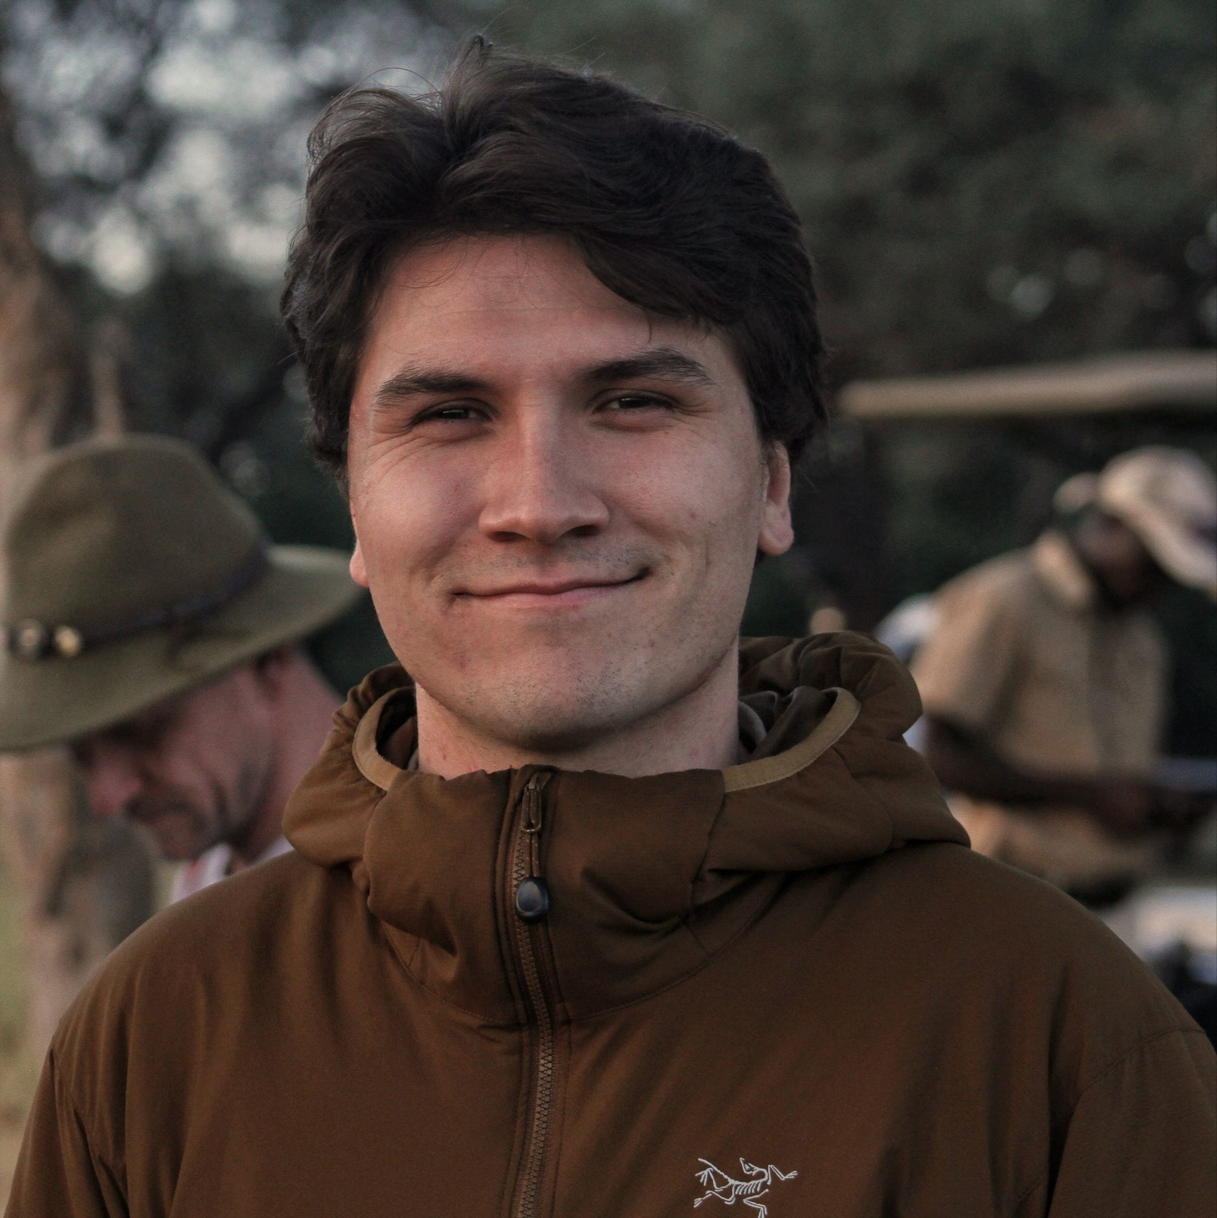
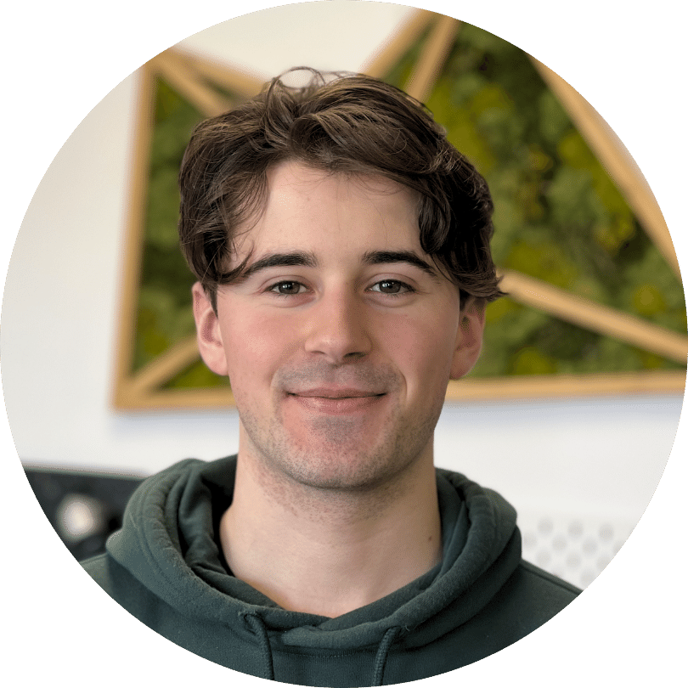
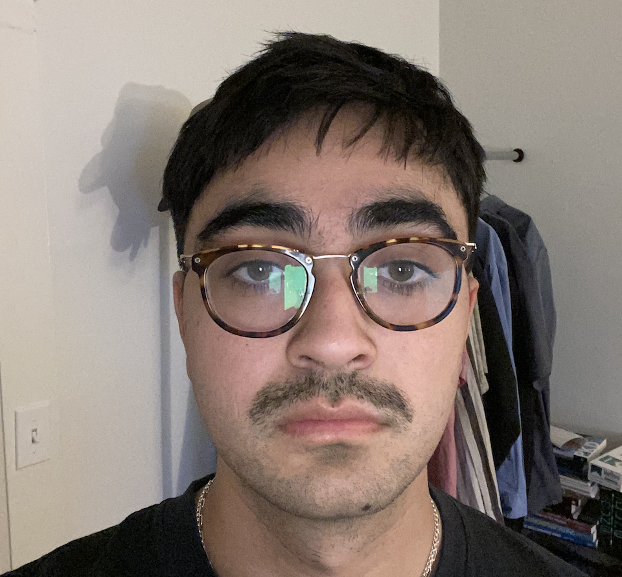
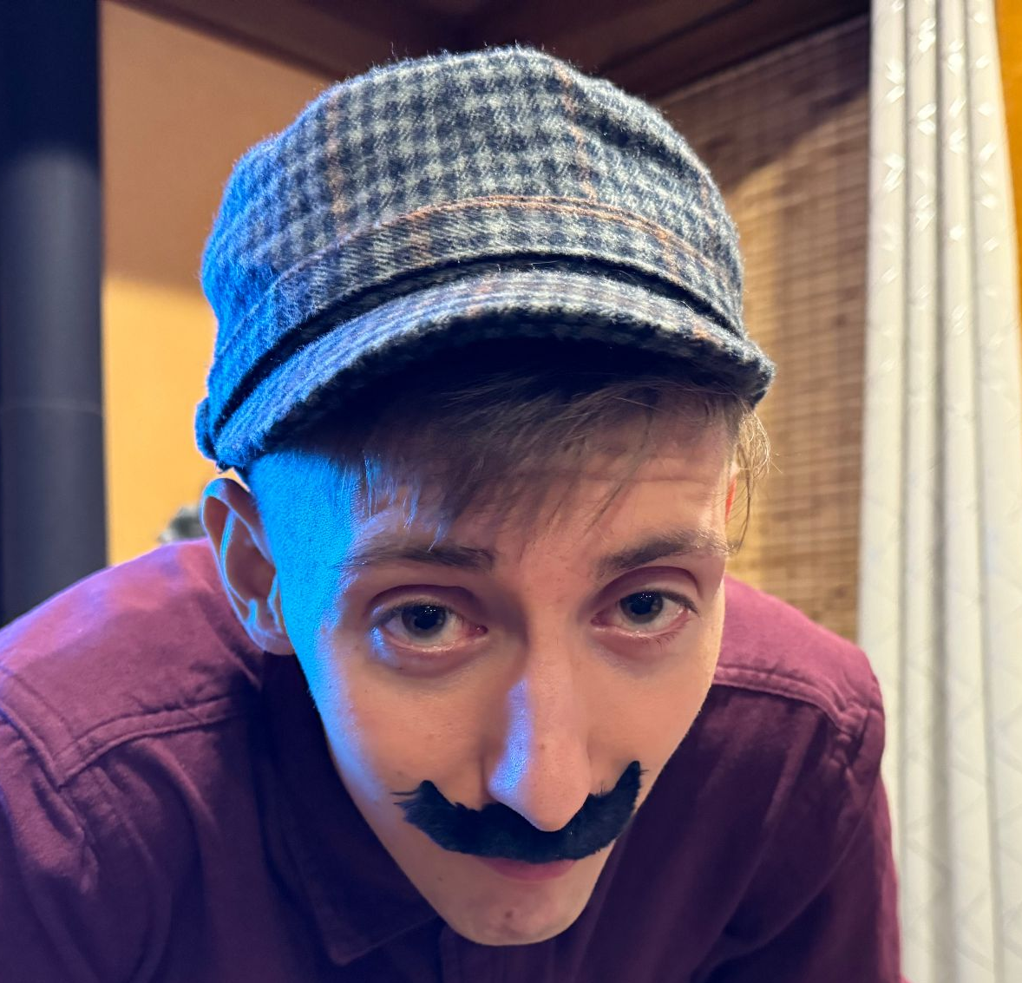
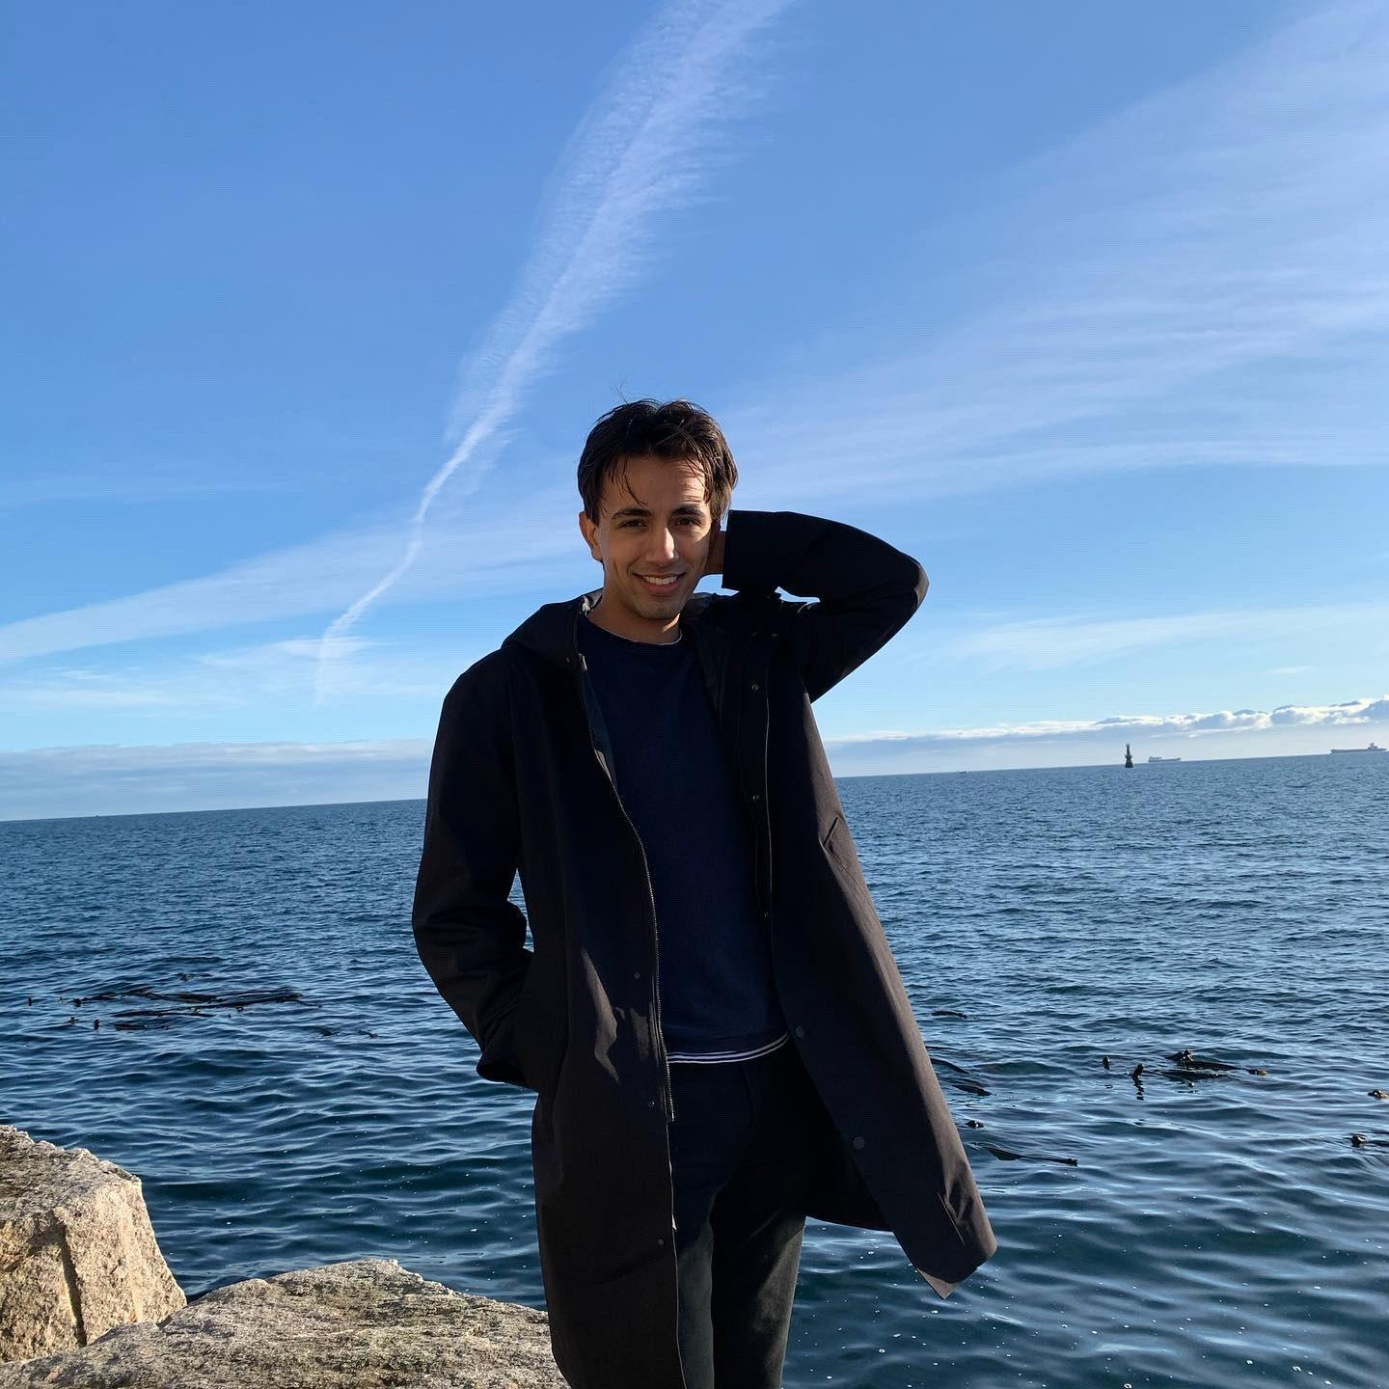
The Restauwants Team
Rebecca Jeon
Cam
Rohwer
Callum
Curtis
Devin
Frioud
Norman
Anderson
Nick
Badyal
Uniting food lovers, one plate at a time!
CREDITS: This presentation template was created by Slidesgo, and includes icons by Flaticon and infographics & images by Freepik

